Slide 1
Compiler Design Finite automata
Dr. Bhawana Tyagi

Slide 2
Finite Automata

Slide 3
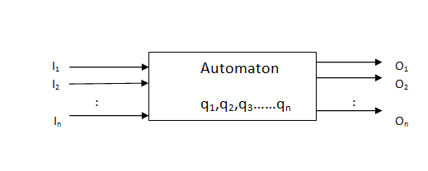
Automata
It is a simplified, formalized model of a computer. It may be used to compute the membership for a language.
Model of a discrete automaton is:

Slide 4
Characteristics of an Automata
Input: At each of the discrete instant of time t1,t2,…. input values I1,I2…, each of which can a finite number of fixed values from the input alphabet ∑ , are applied to the input side of model.
Output: O1,O2… are outputs of the model, each of which can take finite numbers of fixed values from an output.
States: At any instant of time the automaton can be in one of the states q1,q2,…qn.
State relation: the next state of an automaton at any instant of time is determined by the present state and present input.
Output relation: Output is related to either state only or to both the input and the state.

Slide 5
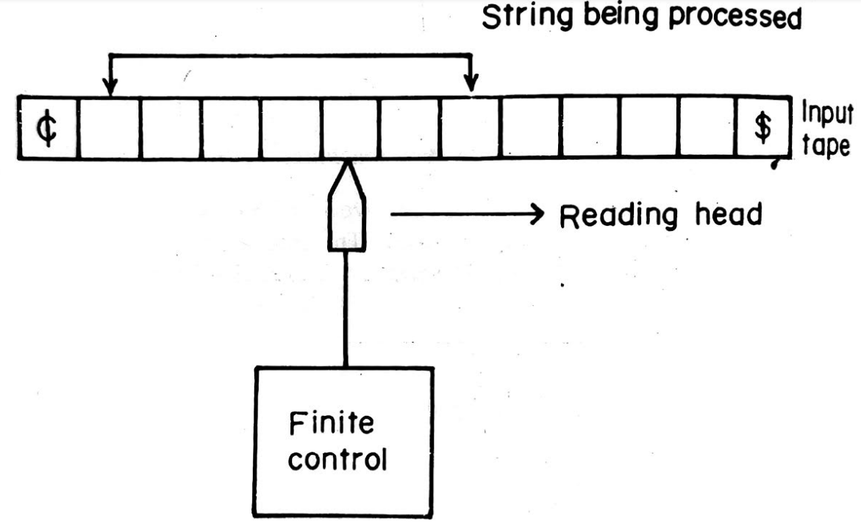
Block Diagram of Finite Automata

Slide 6
Deterministic Finite Automata
A DFA can be represented by a 5-tuple (Q,Σ,δ,q₀,F) where –
Q is a set of states
Σ is the alphabet (of input symbols)
δ: Q × Σ → Q is the transition function
q0 ∈ Q -- the start state or initial state
F ⊆ Q – is the set of final states
δ: (Q x Σ) –> Q δ is defined for any q in Q and s in Σ, and
δ(q,s) = q’ is equal to some state q’ in Q, could be q’=q

Slide 7
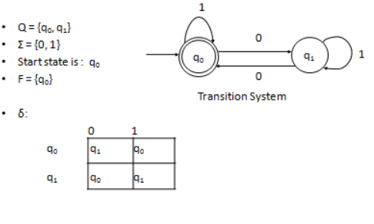
Example of DFA

Slide 8
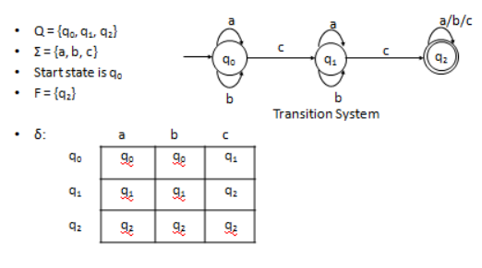
Example 2

Slide 9
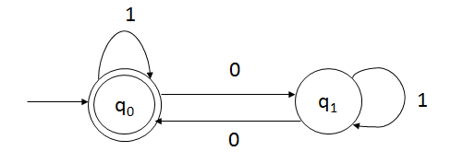
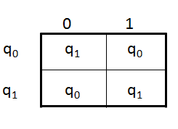
Acceptability of a string by a Finite Automata
A string x is accepted by a finite automaton M=(Q,Σ,δ,q₀,F) if δ(q0,x)=q for some qϵ F.
The acceptability of a string by the final state.
Example: Check S=1001 is acceptable by the
given transition diagram?
δ(q0,1001)=δ(q0,001)
=δ(q1,01)
=δ(q0,1)
=δ(q0,^)=q0
Hence, q0 is the final state so the given string is
Acceptable by the given automata.

Slide 10
Non Deterministic Finite Automata
An NFA can be represented by a five-tuple (Q, Σ, δ, q₀, F) where
Q: A finite set of states
Σ : A finite input alphabet
q_{0:} The initial/starting state, q₀ is in Q
F: A set of final/accepting states, which is a subset of Q
δ : A transition function, which is a total function from Q x Σ to 2^{Q}
δ: (Q x Σ) –> 2^{Q} :2^{Q} is the power set of Q, the set of all subsets of Q δ(q,s) :The set of all states p such that there is a transition labeled s from q to p
δ(q,s) is a function from Q x S to 2^{Q} (but not only to Q)

Slide 11
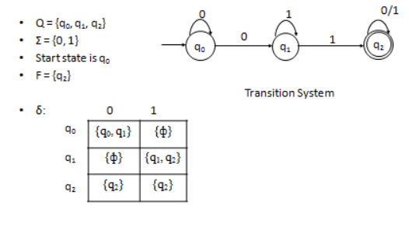
Example : one or more 0’s followed by one or more 1’s

Slide 12
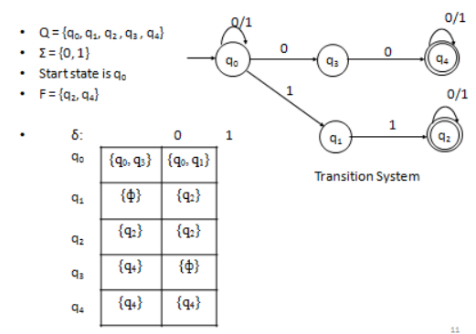
Example : pair of 0’s or pair of 1’s as substring

Slide 13








Regular expression to NFA using Thompson's rule
For $∈$ , construct the NFA
For $a$ in $Σ$, construct the NFA
For regular expression $st$
Ex: ab
start
N(s)
N(t)
$$i$$
$$f$$
start
$$i$$
𝜖
$$f$$
start
$$i$$
a
$$f$$
a
b
1
2
3

Slide 14








Regular expression to NFA using Thompson's rule
For regular expression $s|t$
Ex: (a|b)
For regular expression $s$*
Ex: a*
N(s)
𝜖
𝜖
𝜖
start
$$i$$
𝜖
N(s)
𝜖
$$f$$
start
$$i$$
$$f$$
N(t)
𝜖
𝜖
𝜖
𝜖
2
a
3
𝜖
𝜖
1
𝜖
2
$$a$$
3
𝜖
$$4$$
1
6
𝜖
4
5
𝜖
𝜖
b

Slide 15









Regular expression to NFA using Thompson's rule
a*b
b*ab
1
𝜖
2
$$a$$
3
𝜖
$$4$$
$$b$$
$$5$$
𝜖
𝜖
1
𝜖
2
$$b$$
3
𝜖
$$4$$
$$a$$
5
$$b$$
$$6$$
𝜖

Slide 16
Exercise
Convert following regular expression to NFA:
abba
bb(a)*
(a|b)*
a* | b*
a(a)*ab
aa*+ bb*
(a+b)*abb
10(0+1)*1
(a+b)*a(a+b)
(0+1)*010(0+1)*
(010+00)*(10)*

Slide 17
Conversion from NFA to DFA using subset construction method

Slide 18
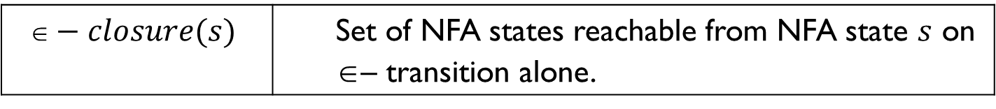

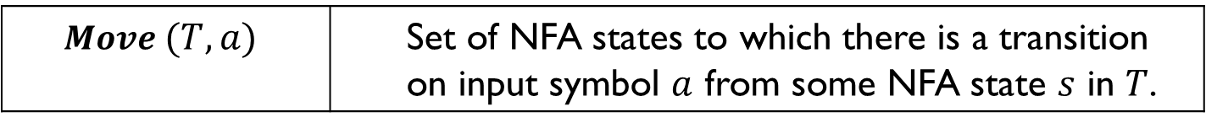
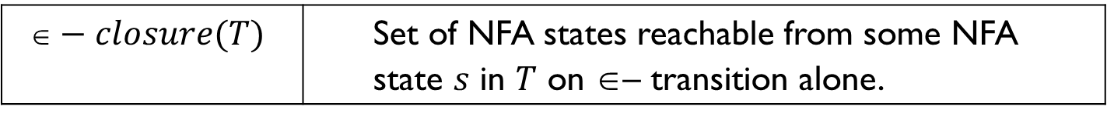
Subset construction algorithm
Input: An NFA $N$.
Output: A DFA D accepting the same language.
Method: Algorithm construct a transition table $Dtran$ for D. We use the following operation:
OPERATION | DESCRIPTION
$$−closure(s)$$ | Set of NFA states reachable from NFA state $s$ on $$– transition alone.
$$−closure(T)$$ | Set of NFA states reachable from some NFA state $s$ in $T$ on $$– transition alone.
$$Move (T,a)$$ | Set of NFA states to which there is a transition on input symbol $a$ from some NFA state $s$ in $T$.

Slide 19
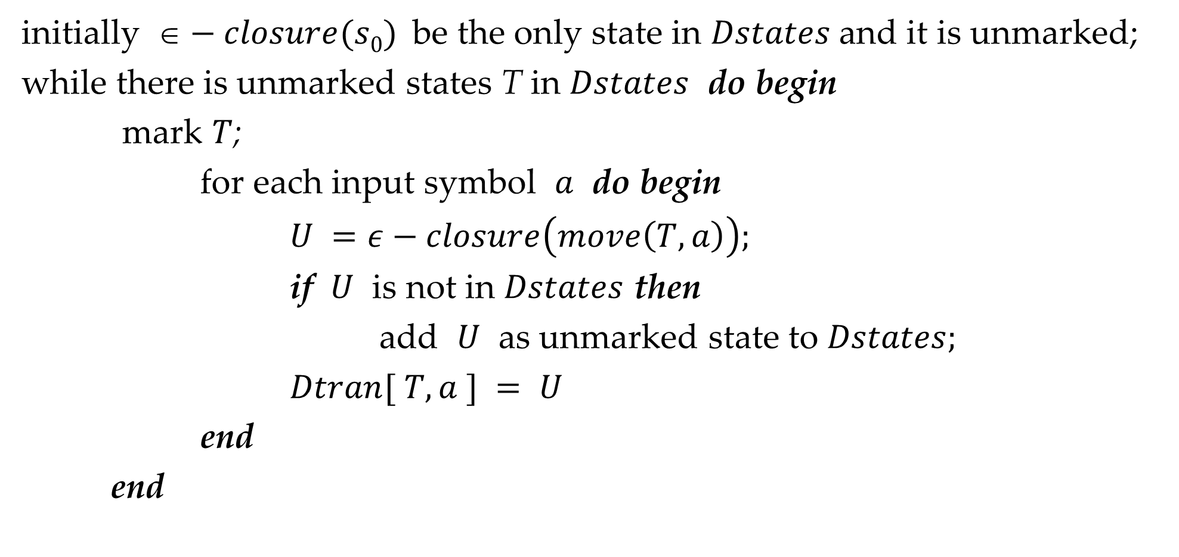
Subset construction algorithm
initially $−closure(s0)$be the only state in $Dstates$and it is unmarked;
while there is unmarked states T in $Dstates$ do begin
mark $T$;
for each input symbol $a$ do begin
$U =ε−closure\left(move\left(T, a\right)\right);$
if $U$ is not in $Dstates$ then
add $U$ as unmarked state to $Dstates;$
$Dtran[ T, a ] = U$
end
end

Slide 20
Conversion from NFA to DFA
*
(a|b)
abb
𝜖
a
2
3
𝜖
𝜖
𝜖
𝜖
7
a
8
b
9
b
10
0
1
6
𝜖
4
5
𝜖
b
𝜖

Slide 21
Conversion from NFA to DFA
𝜖
a
2
3
𝜖
𝜖
𝜖
𝜖
7
a
8
b
9
b
10
0
1
6
𝜖
4
5
𝜖
b
𝜖
𝜖- Closure(0)=
{0, 1, 7, 2, 4}
= {0,1,2,4,7}
---- A

Slide 22
Conversion from NFA to DFA
𝜖
a
States | a | b
2
3
𝜖
𝜖
A = {0,1,2,4,7} | B
𝜖
𝜖
7
a
8
b
9
b
10
0
1
6
B = {1,2,3,4,6,7,8}
𝜖
4
5
𝜖
b
𝜖
A= {0, 1, 2, 4, 7}
Move(A,a)
= {3,8}
= {1,2,3,4,6,7,8}
𝜖- closure(Move(A,a))
= {3, 6, 7, 1, 2, 4, 8}
---- B

Slide 23
Conversion from NFA to DFA
𝜖
a
States | a | b
2
3
𝜖
𝜖
A = {0,1,2,4,7} | B | C
𝜖
𝜖
7
a
8
b
9
b
10
0
1
6
B = {1,2,3,4,6,7,8}
𝜖
4
5
𝜖
C = {1,2,4,5,6,7}
b
𝜖
A= {0, 1, 2, 4, 7}
Move(A,b) =
{5}
𝜖- Closure(Move(A,b)) =
{5, 6, 7, 1, 2, 4}
- --- C
= {1,2,4,5,6,7}

Slide 24
Conversion from NFA to DFA
𝜖
a
States | a | b
2
3
𝜖
𝜖
A = {0,1,2,4,7} | B | C
𝜖
𝜖
7
a
8
b
9
b
10
0
1
6
B = {1,2,3,4,6,7,8} | B
𝜖
4
5
𝜖
C = {1,2,4,5,6,7}
b
𝜖
B = {1, 2, 3, 4, 6, 7, 8}
Move(B,a)
= {3,8}
𝜖- Closure(Move(B,a))
= {3, 6, 7, 1, 2, 4, 8}
= {1,2,3,4,6,7,8}
---- B

Slide 25
Conversion from NFA to DFA
𝜖
a
States | a | b
2
3
𝜖
𝜖
A = {0,1,2,4,7} | B | C
𝜖
𝜖
7
a
8
b
9
b
10
0
1
6
B = {1,2,3,4,6,7,8} | B | D
𝜖
4
5
𝜖
C = {1,2,4,5,6,7}
b
D = {1,2,4,5,6,7,9}
𝜖
B= {1, 2, 3, 4, 6, 7, 8}
Move(B,b)
= {5,9}
𝜖- Closure(Move(B,b))
= {5, 6, 7, 1, 2, 4, 9}
= {1,2,4,5,6,7,9}
---- D

Slide 26
Conversion from NFA to DFA
𝜖
a
States | a | b
2
3
𝜖
𝜖
A = {0,1,2,4,7} | B | C
𝜖
𝜖
7
a
8
b
9
b
10
0
1
6
B = {1,2,3,4,6,7,8} | B | D
𝜖
4
5
𝜖
C = {1,2,4,5,6,7} | B
b
D = {1,2,4,5,6,7,9}
𝜖
C= {1, 2, 4, 5, 6 ,7}
Move(C,a)
= {3,8}
𝜖- Closure(Move(C,a))
= {3, 6, 7, 1, 2, 4, 8}
= {1,2,3,4,6,7,8}
---- B

Slide 27
Conversion from NFA to DFA
𝜖
a
States | a | b
2
3
𝜖
𝜖
A = {0,1,2,4,7} | B | C
𝜖
𝜖
7
a
8
b
9
b
10
0
1
6
B = {1,2,3,4,6,7,8} | B | D
𝜖
4
5
𝜖
C = {1,2,4,5,6,7} | B | C
b
D = {1,2,4,5,6,7,9}
𝜖
C= {1, 2, 4, 5, 6, 7}
Move(C,b) =
{5}
𝜖- Closure(Move(C,b))=
{5, 6, 7, 1, 2, 4}
= {1,2,4,5,6,7}
---- C

Slide 28
Conversion from NFA to DFA
𝜖
a
States | a | b
2
3
𝜖
𝜖
A = {0,1,2,4,7} | B | C
𝜖
𝜖
7
a
8
b
9
b
10
0
1
6
B = {1,2,3,4,6,7,8} | B | D
𝜖
4
5
𝜖
C = {1,2,4,5,6,7} | B | C
b
D = {1,2,4,5,6,7,9} | B
𝜖
D= {1, 2, 4, 5, 6, 7, 9}
Move(D,a)
= {3,8}
𝜖- Closure(Move(D,a))
= {3, 6, 7, 1, 2, 4, 8}
= {1,2,3,4,6,7,8}
---- B

Slide 29
Conversion from NFA to DFA
𝜖
a
States | a | b
2
3
𝜖
𝜖
A = {0,1,2,4,7} | B | C
𝜖
𝜖
7
a
8
b
9
b
10
0
1
6
B = {1,2,3,4,6,7,8} | B | D
𝜖
4
5
𝜖
C = {1,2,4,5,6,7} | B | C
b
D = {1,2,4,5,6,7,9} | B | E
𝜖
E = {1,2,4,5,6,7,10}
D= {1, 2, 4, 5, 6, 7, 9}
Move(D,b)
= {5,10}
𝜖- Closure(Move(D,b))
= {5, 6, 7, 1, 2, 4, 10}
= {1,2,4,5,6,7,10}
---- E

Slide 30
Conversion from NFA to DFA
𝜖
a
States | a | b
2
3
𝜖
𝜖
A = {0,1,2,4,7} | B | C
𝜖
𝜖
7
a
8
b
9
b
10
0
1
6
B = {1,2,3,4,6,7,8} | B | D
𝜖
4
5
𝜖
C = {1,2,4,5,6,7} | B | C
b
D = {1,2,4,5,6,7,9} | B | E
𝜖
E = {1,2,4,5,6,7,10} | B
E= {1, 2, 4, 5, 6, 7, 10}
Move(E,a)
= {3,8}
𝜖- Closure(Move(E,a))
= {3, 6, 7, 1, 2, 4, 8}
= {1,2,3,4,6,7,8}
---- B

Slide 31
Conversion from NFA to DFA
𝜖
a
States | a | b
2
3
𝜖
𝜖
A = {0,1,2,4,7} | B | C
𝜖
𝜖
7
a
8
b
9
b
10
0
1
6
B = {1,2,3,4,6,7,8} | B | D
𝜖
4
5
𝜖
C = {1,2,4,5,6,7} | B | C
b
D = {1,2,4,5,6,7,9} | B | E
𝜖
E = {1,2,4,5,6,7,10} | B | C
E= {1, 2, 4, 5, 6, 7, 10}
Move(E,b)=
{5}
𝜖- Closure(Move(E,b))=
{5,6,7,1,2,4}
= {1,2,4,5,6,7}
---- C

Slide 32





Conversion from NFA to DFA
a
b
States | a | b
$$B$$
$$D$$
a
A = {0,1,2,4,7} | B | C
a
B = {1,2,3,4,6,7,8} | B | D
$$A$$
a
a
b
C = {1,2,4,5,6,7} | B | C
D = {1,2,4,5,6,7,9} | B | E
b
$$C$$
$$E$$
E = {1,2,4,5,6,7,10} | B | C
b
Transition Table
b
Note:
Accepting state in NFA is 10
10 is element of E
So, E is acceptance state in DFA
DFA

Slide 33
Exercise
Convert following regular expression to DFA using subset construction method:
(a+b)*a(a+b)
(a+b)*ab*a

Slide 34
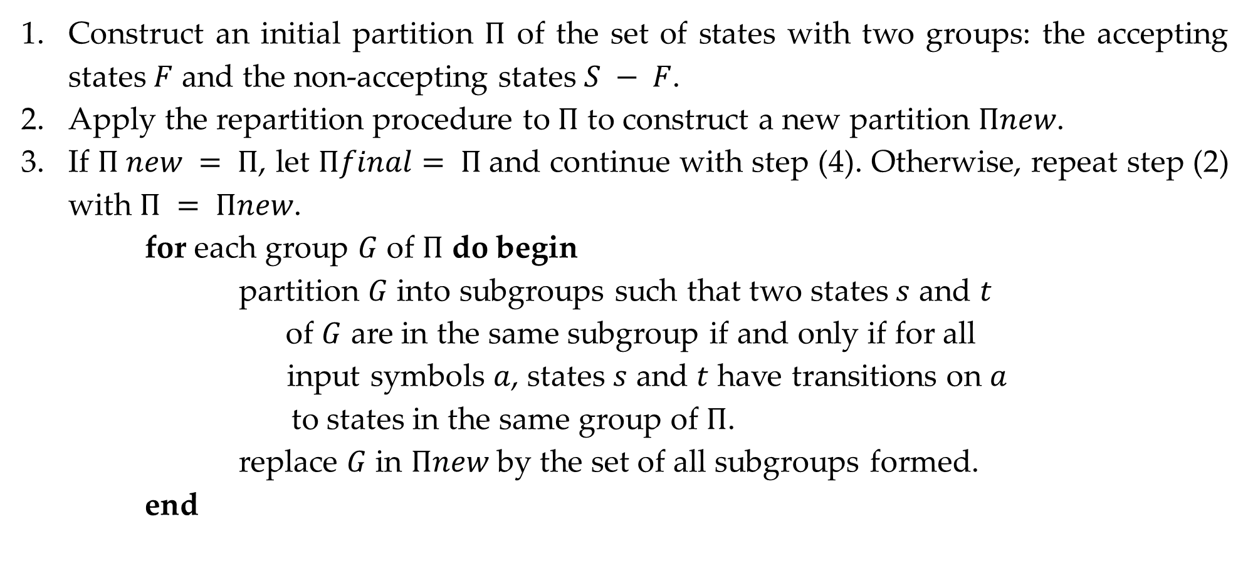
DFA optimization
Construct an initial partition $Π$ of the set of states with two groups: the accepting states $F$ and the non-accepting states $S − F$.
Apply the repartition procedure to $Π$ to construct a new partition $Πnew$.
If $Π new = Π$, let $Πfinal= Π$and continue with step (4). Otherwise, repeat step (2) with $Π = Πnew$.
for each group $G$ of $Π$ do begin
partition $G$ into subgroups such that two states $s$ and $t$
of $G$ are in the same subgroup if and only if for all
input symbols $a$, states $s$ and $t$ have transitions on $a$
to states in the same group of $Π$.
replace $G$ in $Πnew$ by the set of all subgroups formed.
end

Slide 35
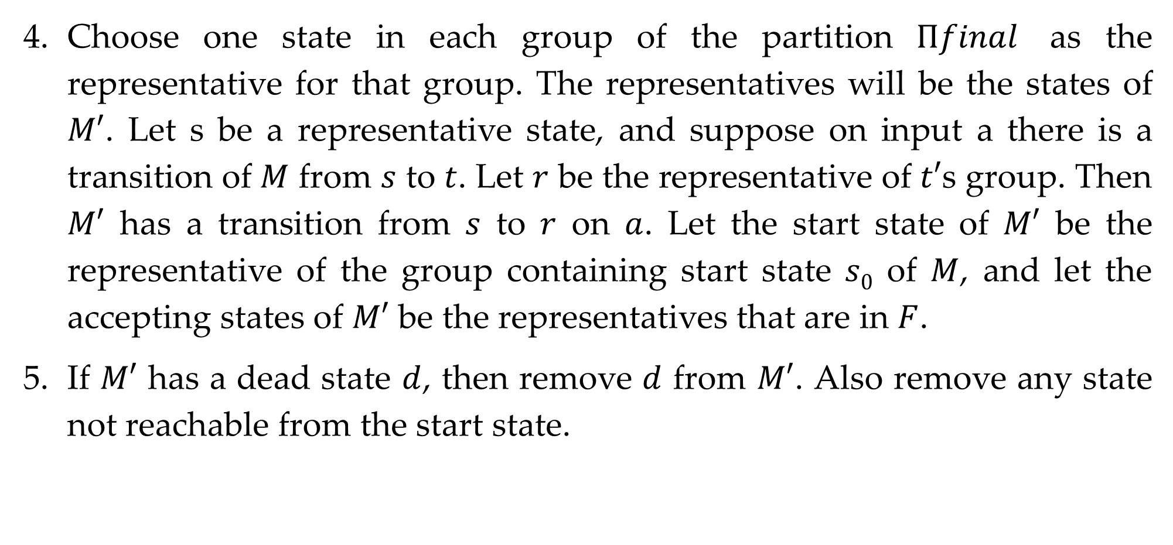
DFA optimization
Choose one state in each group of the partition $Πfinal$ as the representative for that group. The representatives will be the states of $M′$. Let s be a representative state, and suppose on input a there is a transition of $M$ from $s$ to $t$. Let $r$ be the representative of $t′$s group. Then $M′$ has a transition from $s$ to $r$ on $a$. Let the start state of $M′$ be the representative of the group containing start state $s0$ of $M$, and let the accepting states of $M′$ be the representatives that are in $F$.
If $M′$ has a dead state $d$, then remove $d$ from $M′$. Also remove any state not reachable from the start state.

Slide 36




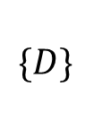
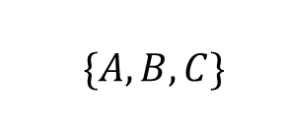

DFA optimization
States | a | b
$$\{A,B,C,D,E\}$$
A | B | C
Nonaccepting States $\{A,B,C,D\}$
Accepting States
$$\{E\}$$
B | B | D
C | B | C
D | B | E
$\{A,B,C\}$
$$\{D\}$$
E | B | C
$\{A,C\}$
$\{B\}$
States | a | b
A | B | A
B | B | D
Now no more splitting is possible.
If we chose A as the representative for group (AC), then we obtain reduced transition table
D | B | E
E | B | A
Optimized Transition Table

Slide 37
Conversion from regular expression to DFA

Slide 38
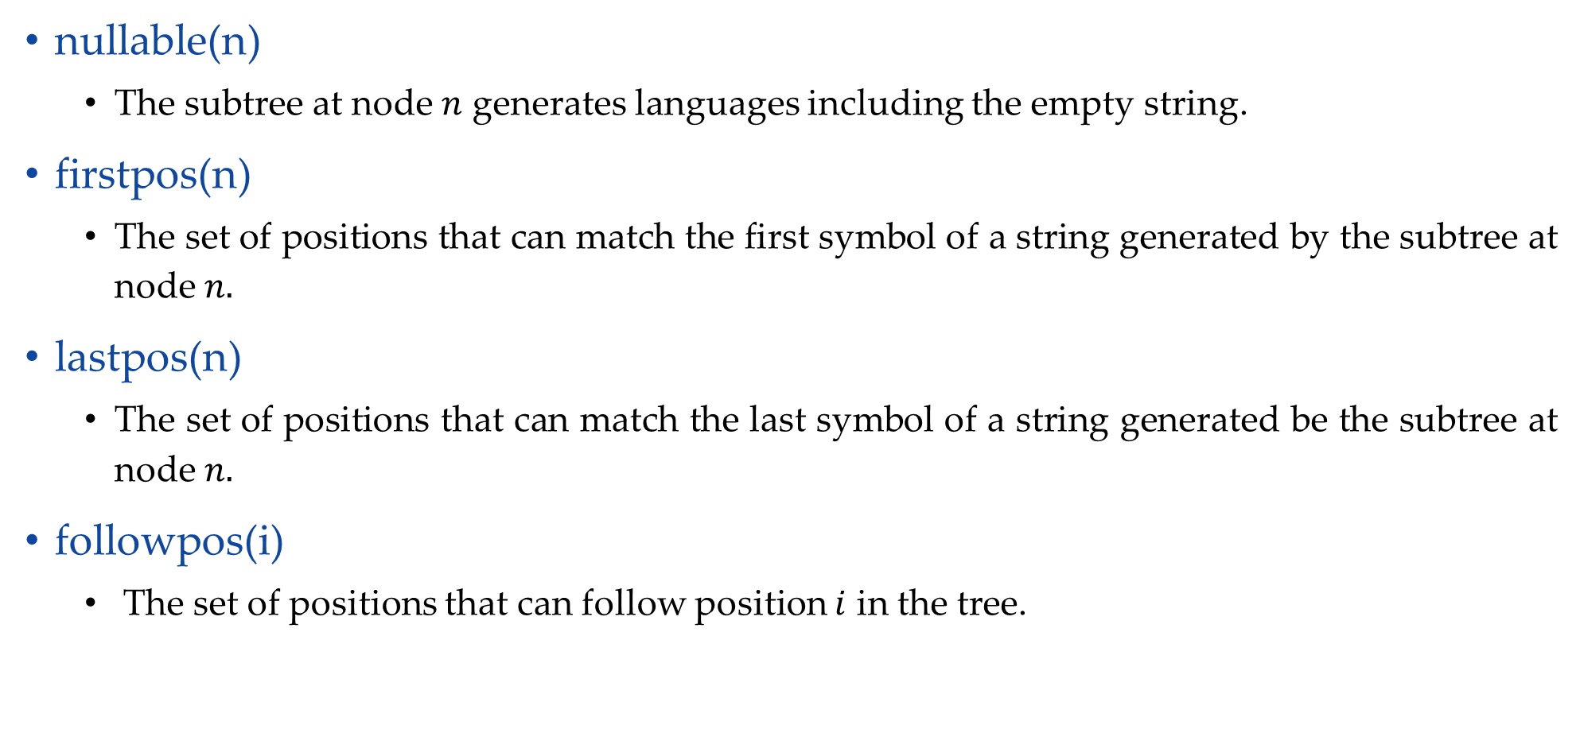
Rules to compute nullable, firstpos, lastpos
nullable(n)
The subtree at node $n$ generates languages including the empty string.
firstpos(n)
The set of positions that can match the first symbol of a string generated by the subtree at node $n.$
lastpos(n)
The set of positions that can match the last symbol of a string generated be the subtree at node $n.$
followpos(i)
The set of positions that can follow position $i$ in the tree.

Slide 39



Rules to compute nullable, firstpos, lastpos
Node n | nullable(n) | firstpos(n) | lastpos(n)
A leaf labeled by $$ | true | $$∅$$ | $$∅$$
A leaf with position $i$ | false | $$\{i\}$$ | $$\{i\}$$
 | nullable(c₁) or nullable(c₂) | firstpos(c₁) ∪ firstpos(c₂) | lastpos(c₁) ∪ lastpos(c₂)
n
$$|$$
c₁
c₂
 | nullable(c₁) and nullable(c₂) | if (nullable(c₁)) then firstpos(c₁) ∪ firstpos(c₂) else firstpos(c₁) | if (nullable(c₂)) then lastpos(c₁) ∪ lastpos(c₂) else lastpos(c₂)
n
$$.$$
c₁
c₂
 | true | firstpos(c₁) | lastpos(c₁)
n
$$∗$$
c₁

Slide 40
Rules to compute followpos
If n is concatenation node with left child c1 and right child c2 and i is a position in lastpos(c1), then all position in firstpos(c2) are in followpos(i)
If n is * node and i is position in lastpos(n), then all position in firstpos(n) are in followpos(i)

Slide 41














Conversion from regular expression to DFA
(a|b)
abb
Step 1: Construct Syntax Tree
*
#
.
Step 2: Nullable node
Here, * is only nullable node
.
$$\#$$
.
$$6$$
$$b$$
.
$$5$$
$$b$$
$$4$$
$$∗$$
$$a$$
$$3$$
$$|$$
$$a$$
$$b$$
$$1$$
$$2$$

Slide 42
















Conversion from regular expression to DFA
Step 3: Calculate firstpos
Firstpos
$$\{1,2,3\}$$
.
$$\{1,2,3\}$$
.
A leaf with position $i=\{i\}$
$$\{6\}$$
$$\#$$
$$\{1,2,3\}$$
.
$$6$$
$$\{5\}$$
$$b$$
n
$$|$$
$$\{1,2,3\}$$
.
$$5$$
firstpos(c₁) ∪ firstpos(c₂)
$$\{4\}$$
$$b$$
$$4$$
c₁
c₂
$$\{1,2\}$$
$$∗$$
$$\{3\}$$
$$a$$
$$∗$$
n
$$3$$
firstpos(c₁)
$$|$$
c₁
$$\{1,2\}$$
n
if (nullable(c₁))
thenfirstpos(c₁) ∪ firstpos(c₂) else firstpos(c₁)
$$.$$
$$a$$
$$b$$
$$\{1\}$$
$$1$$
$$\{2\}$$
$$2$$
c₁
c₂

Slide 43






















Conversion from regular expression to DFA
Step 3: Calculate lastpos
Lastpos
$$\{1,2,3\}$$
.
$$\{6\}$$
$$\{1,2,3\}$$
.
$$\{5\}$$
$$\{6\}$$
$$\{6\}$$
A leaf with position $i=\{i\}$
$$\#$$
$$\{1,2,3\}$$
.
$$6$$
$$\{4\}$$
$$\{5\}$$
$$\{5\}$$
n
$$b$$
$$|$$
$$\{1,2,3\}$$
.
$$\{3\}$$
$$5$$
lastpos(c₁) ∪ lastpos(c₂)
$$\{4\}$$
$$b$$
$$\{4\}$$
c₁
c₂
$$4$$
$$\{1,2\}$$
$$∗$$
$$\{1,2\}$$
$$\{3\}$$
$$a$$
$$\{3\}$$
n
$$∗$$
$$3$$
lastpos(c₁)
$$|$$
c₁
$$\{1,2\}$$
$$\{1,2\}$$
n
$$.$$
if (nullable(c₂)) then lastpos(c₁) ∪ lastpos(c₂) else lastpos(c₂)
$$a$$
$$b$$
$$\{1\}$$
$$\{1\}$$
$$\{2\}$$
$$\{2\}$$
c₁
$$1$$
$$2$$
c₂

Slide 44

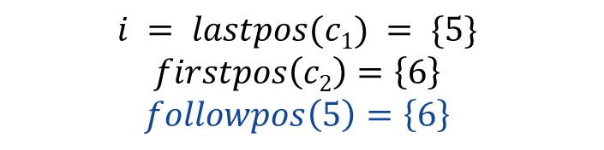





Conversion from regular expression to DFA
Step 4: Calculate followpos
Position | followpos
Firstpos
Lastpos
5 | 6
$$\{1,2,3\}$$
.
$$\{6\}$$
$$\{1,2,3\}$$
.
$$\{5\}$$
$$\{6\}$$
$$\{6\}$$
$$\#$$
$$\{1,2,3\}$$
.
$$6$$
$$\{4\}$$
$$\{5\}$$
$$\{5\}$$
$$b$$
$$\{1,2,3\}$$
.
$$\{3\}$$
$$5$$
.
$$\{4\}$$
$$b$$
$$\{4\}$$
$$4$$
$$\{1,2\}$$
$$∗$$
$$\{1,2\}$$
$$\{3\}$$
$$a$$
$$\{3\}$$
$$\{1,2,3\}$$
$$c1$$
$$\{5\}$$
$$\{6\}$$
$$c2$$
$$\{6\}$$
$$3$$
$$\{1,2\}$$
$$|$$
$$\{1,2\}$$
$$i = lastpos(c1) = \{5\}$$
$$firstpos\left(c2\right)=\left\{6\right\}$$
$$followpos\left(5\right)=\left\{6\right\}$$
$$a$$
$$b$$
$$\{1\}$$
$$\{1\}$$
$$\{2\}$$
$$\{2\}$$
$$1$$
$$2$$

Slide 45

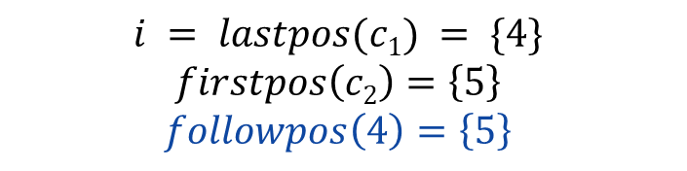


Conversion from regular expression to DFA
Step 4: Calculate followpos
Position | followpos
5 | 6
$$\{1,2,3\}$$
.
$$\{6\}$$
4 | 5
$$\{1,2,3\}$$
.
$$\{5\}$$
$$\{6\}$$
$$\{6\}$$
$$\#$$
$$\{1,2,3\}$$
.
$$6$$
$$\{4\}$$
$$\{5\}$$
$$\{5\}$$
$$b$$
$$\{1,2,3\}$$
.
$$\{3\}$$
$$5$$
.
$$\{4\}$$
$$b$$
$$\{4\}$$
$$4$$
$$\{1,2\}$$
$$∗$$
$$\{1,2\}$$
$$\{3\}$$
$$a$$
$$\{3\}$$
$$\{1,2,3\}$$
$$c1$$
$$\{4\}$$
$$\{5\}$$
$$c2$$
$$\{5\}$$
$$3$$
$$\{1,2\}$$
$$|$$
$$\{1,2\}$$
$$i = lastpos(c1) = \{4\}$$
$$firstpos\left(c2\right)=\left\{5\right\}$$
$$followpos\left(4\right)=\left\{5\right\}$$
$$a$$
$$b$$
$$\{1\}$$
$$\{1\}$$
$$\{2\}$$
$$\{2\}$$
$$1$$
$$2$$

Slide 46




Conversion from regular expression to DFA
Step 4: Calculate followpos
Position | followpos
Firstpos
Lastpos
5 | 6
$$\{1,2,3\}$$
.
$$\{6\}$$
4 | 5
$$\{1,2,3\}$$
.
$$\{5\}$$
3 | 4
$$\{6\}$$
$$\{6\}$$
$$\#$$
$$\{1,2,3\}$$
.
$$6$$
$$\{4\}$$
$$\{5\}$$
$$\{5\}$$
$$b$$
$$\{1,2,3\}$$
.
$$\{3\}$$
$$5$$
.
$$\{4\}$$
$$b$$
$$\{4\}$$
$$4$$
$$\{1,2\}$$
$$∗$$
$$\{1,2\}$$
$$\{3\}$$
$$a$$
$$\{3\}$$
$$\{1,2,3\}$$
$$c1$$
$$\{3\}$$
$$\{4\}$$
$$c2$$
$$\{4\}$$
$$3$$
$$\{1,2\}$$
$$|$$
$$\{1,2\}$$
$$i = lastpos(c1) = \{3\}$$
$$firstpos\left(c2\right)=\left\{4\right\}$$
$$followpos\left(3\right)=\left\{4\right\}$$
$$a$$
$$b$$
$$\{1\}$$
$$\{1\}$$
$$\{2\}$$
$$\{2\}$$
$$1$$
$$2$$

Slide 47





Conversion from regular expression to DFA
Step 4: Calculate followpos
Position | followpos
Firstpos
Lastpos
5 | 6
$$\{1,2,3\}$$
.
$$\{6\}$$
4 | 5
$$\{1,2,3\}$$
.
$$\{5\}$$
3 | 4
$$\{6\}$$
$$\{6\}$$
$$\#$$
.
$$6$$
2 | 3
$$\{1,2,3\}$$
$$\{4\}$$
$$\{5\}$$
$$\{5\}$$
$$b$$
1 | 3
$$\{1,2,3\}$$
.
$$\{3\}$$
$$5$$
.
$$\{4\}$$
$$b$$
$$\{4\}$$
$$4$$
$$\{1,2\}$$
$$∗$$
$$\{1,2\}$$
$$\{3\}$$
$$a$$
$$\{3\}$$
$$\{1,2\}$$
$$c1$$
$$\{1,2\}$$
$$\{3\}$$
$$c2$$
$$\{3\}$$
$$3$$
$$\{1,2\}$$
$$|$$
$$\{1,2\}$$
$$i = lastpos(c1) = \{1,2\}$$
$$firstpos\left(c2\right)=\left\{3\right\}$$
$$followpos\left(1\right)=\left\{3\right\}$$
$$followpos\left(2\right)=\left\{3\right\}$$
$$a$$
$$b$$
$$\{1\}$$
$$\{1\}$$
$$\{2\}$$
$$\{2\}$$
$$1$$
$$2$$

Slide 48




Conversion from regular expression to DFA
Step 4: Calculate followpos
Position | followpos
Firstpos
Lastpos
5 | 6
$$\{1,2,3\}$$
.
$$\{6\}$$
4 | 5
$$\{1,2,3\}$$
.
$$\{5\}$$
3 | 4
$$\{6\}$$
$$\{6\}$$
$$\#$$
2 | 3
.
$$6$$
1,2,
$$\{1,2,3\}$$
$$\{4\}$$
$$\{5\}$$
$$\{5\}$$
$$b$$
1 | 3
1,2,
$$\{1,2,3\}$$
.
$$\{3\}$$
$$5$$
$$\{4\}$$
$$b$$
$$\{4\}$$
$$4$$
$$\{1,2\}$$
*
$$\{1,2\}$$
$$\{1,2\}$$
$$∗$$
$$\{1,2\}$$
$$\{3\}$$
$$a$$
$$\{3\}$$
$$n$$
$$3$$
$$\{1,2\}$$
$$|$$
$$\{1,2\}$$
$$i = lastpos(n) = \{1,2\}$$
$$firstpos\left(n\right)=\left\{1,2\right\}$$
$$followpos\left(1\right)=\left\{1,2\right\}$$
$$followpos\left(2\right)=\left\{1,2\right\}$$
$$a$$
$$b$$
$$\{1\}$$
$$\{1\}$$
$$\{2\}$$
$$\{2\}$$
$$1$$
$$2$$

Slide 49
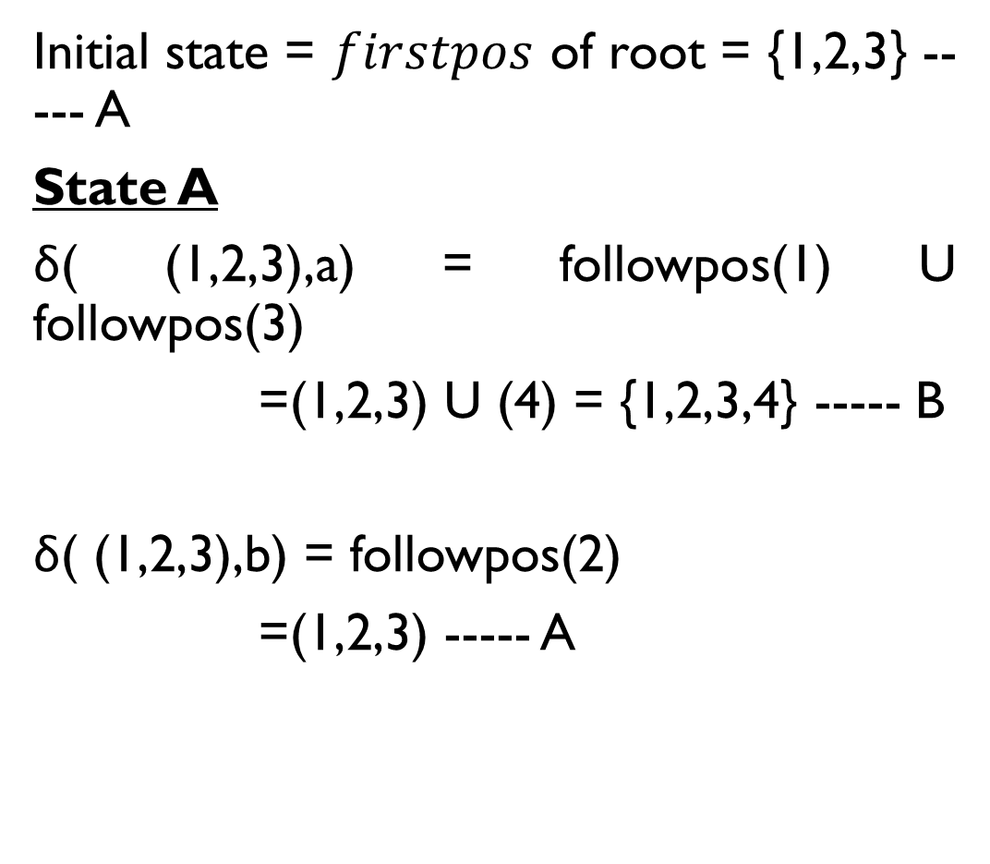
Conversion from regular expression to DFA
Initial state = $firstpos$ of root = {1,2,3} ----- A
State A
δ( (1,2,3),a) = followpos(1) U followpos(3)
=(1,2,3) U (4) = {1,2,3,4} ----- B
δ( (1,2,3),b) = followpos(2)
=(1,2,3) ----- A
Position | followpos
5 | 6
4 | 5
3 | 4
2 | 1,2,3
1 | 1,2,3
States | a | b
A={1,2,3} | B | A
B={1,2,3,4}

Slide 50
Conversion from regular expression to DFA
State B
δ( (1,2,3,4),a) = followpos(1) U followpos(3)
=(1,2,3) U (4) = {1,2,3,4} ----- B
δ( (1,2,3,4),b) = followpos(2) U followpos(4)
=(1,2,3) U (5) = {1,2,3,5} ----- C
State C
δ( (1,2,3,5),a) = followpos(1) U followpos(3)
=(1,2,3) U (4) = {1,2,3,4} ----- B
δ( (1,2,3,5),b) = followpos(2) U followpos(5)
=(1,2,3) U (6) = {1,2,3,6} ----- D
Position | followpos
5 | 6
4 | 5
3 | 4
2 | 1,2,3
1 | 1,2,3
States | a | b
A={1,2,3} | B | A
B={1,2,3,4} | B | C
C={1,2,3,5} | B | D
D={1,2,3,6}

Slide 51
Conversion from regular expression to DFA
State D
δ( (1,2,3,6),a) = followpos(1) U followpos(3)
=(1,2,3) U (4) = {1,2,3,4} ----- B
δ( (1,2,3,6),b) = followpos(2)
=(1,2,3) ----- A
Position | followpos
5 | 6
4 | 5
3 | 4
2 | 1,2,3
1 | 1,2,3
b
States | a | b
a
A={1,2,3} | B | A
A
a
B
b
C
b
D
B={1,2,3,4} | B | C
C={1,2,3,5} | B | D
a
a
D={1,2,3,6} | B | A
b
DFA

